Slide 1

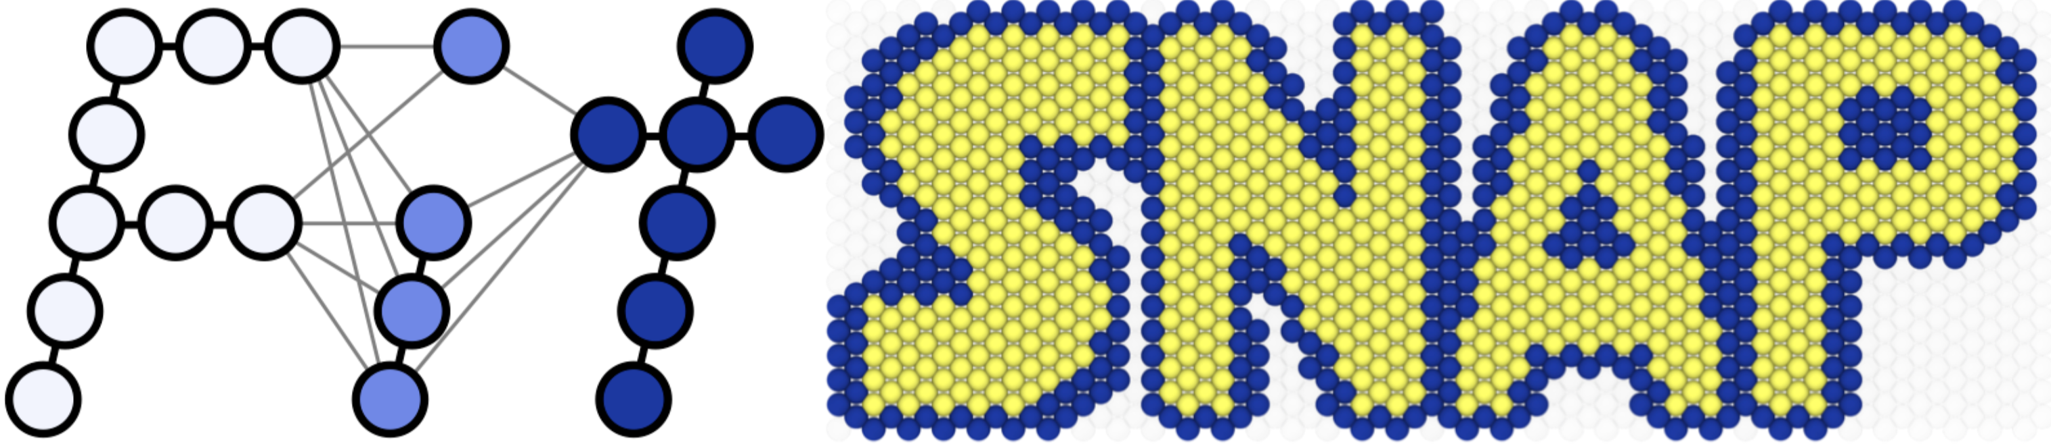
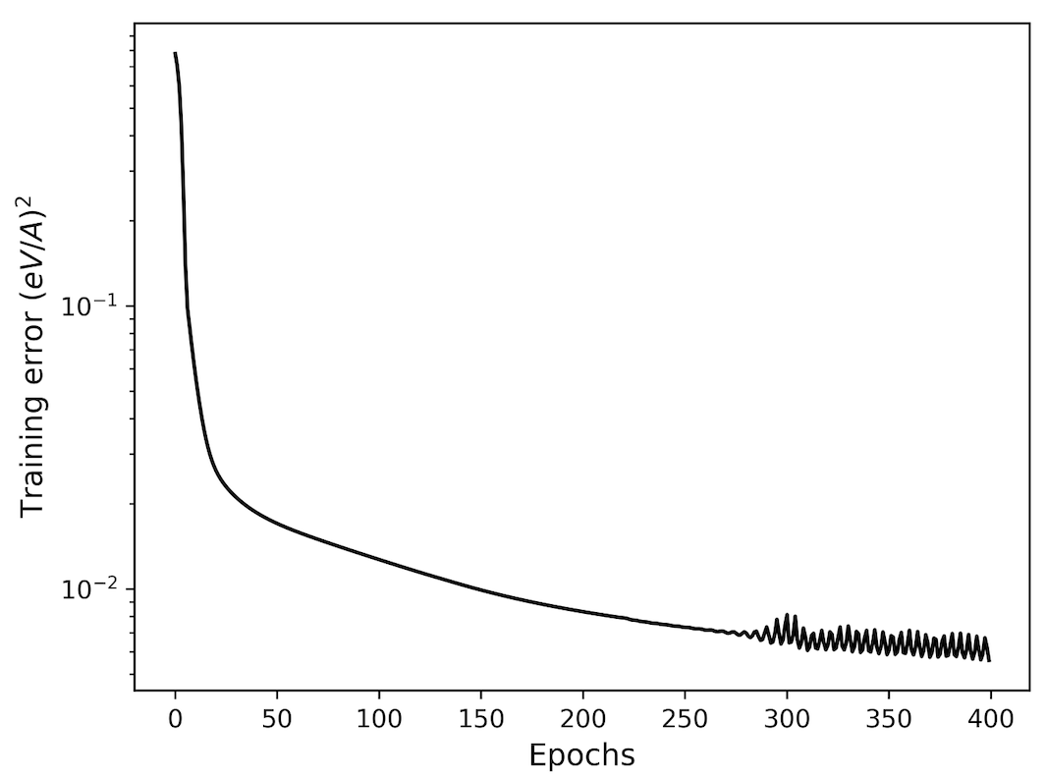
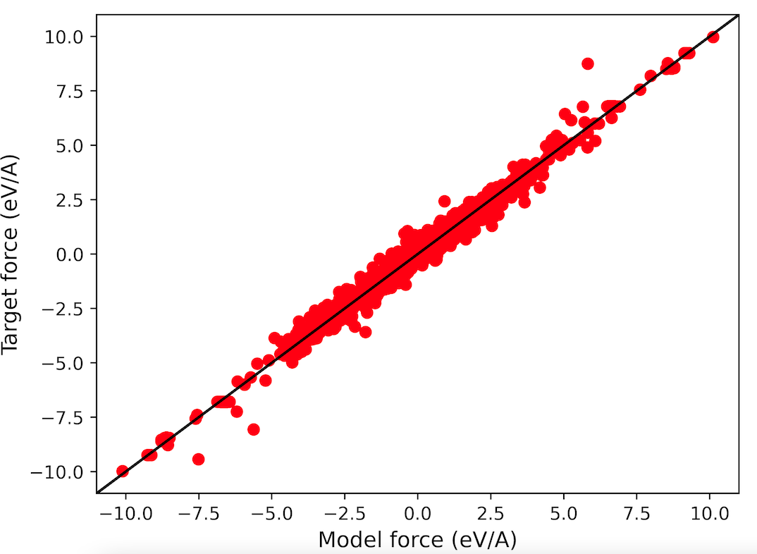
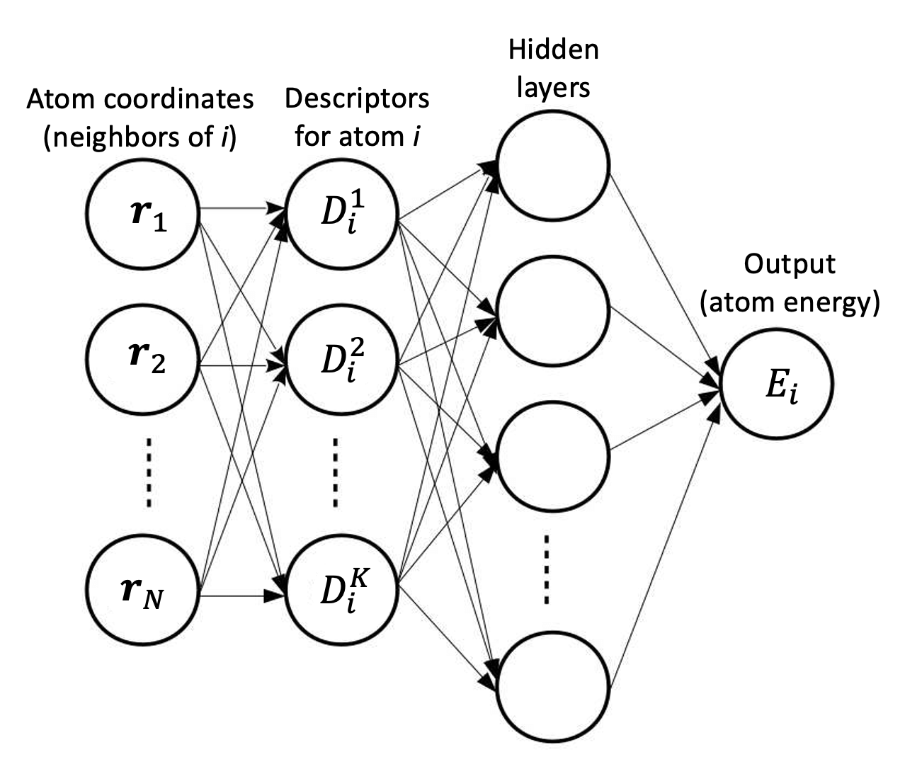
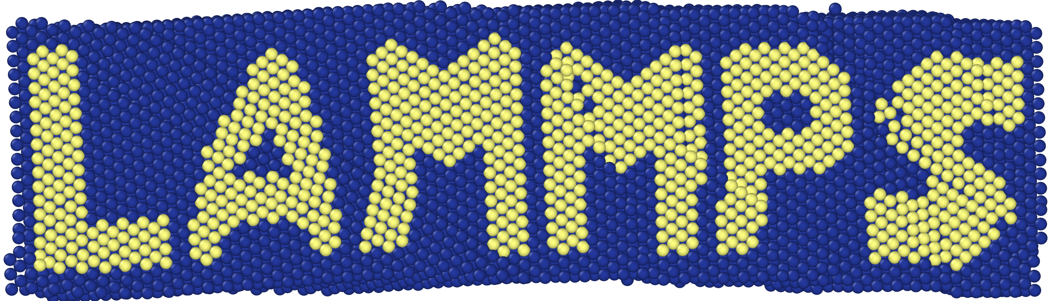
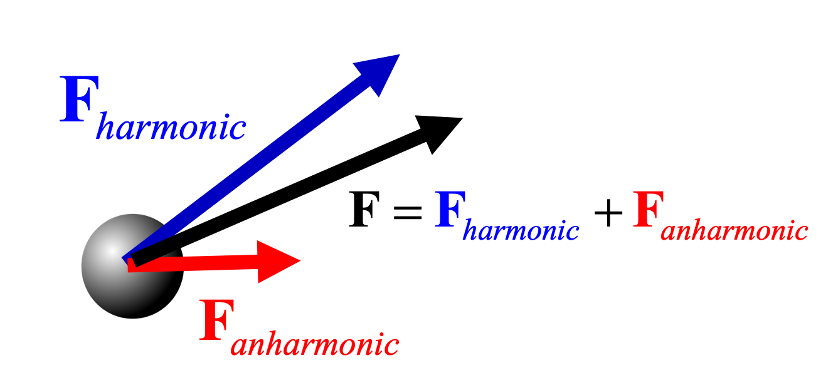
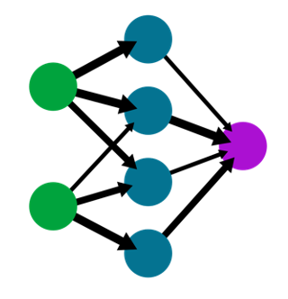
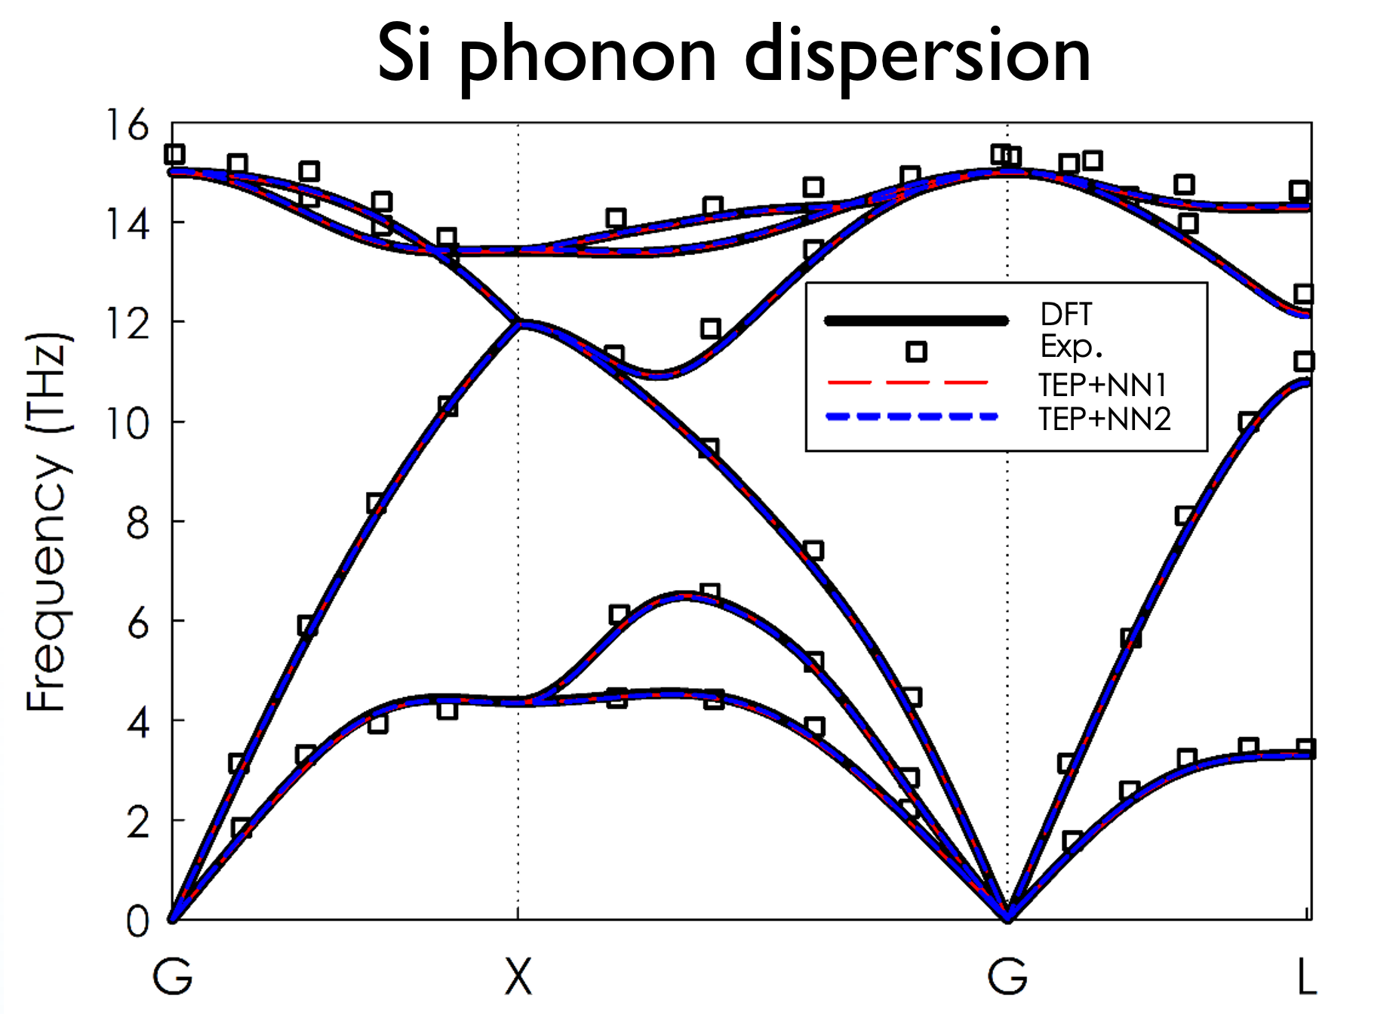
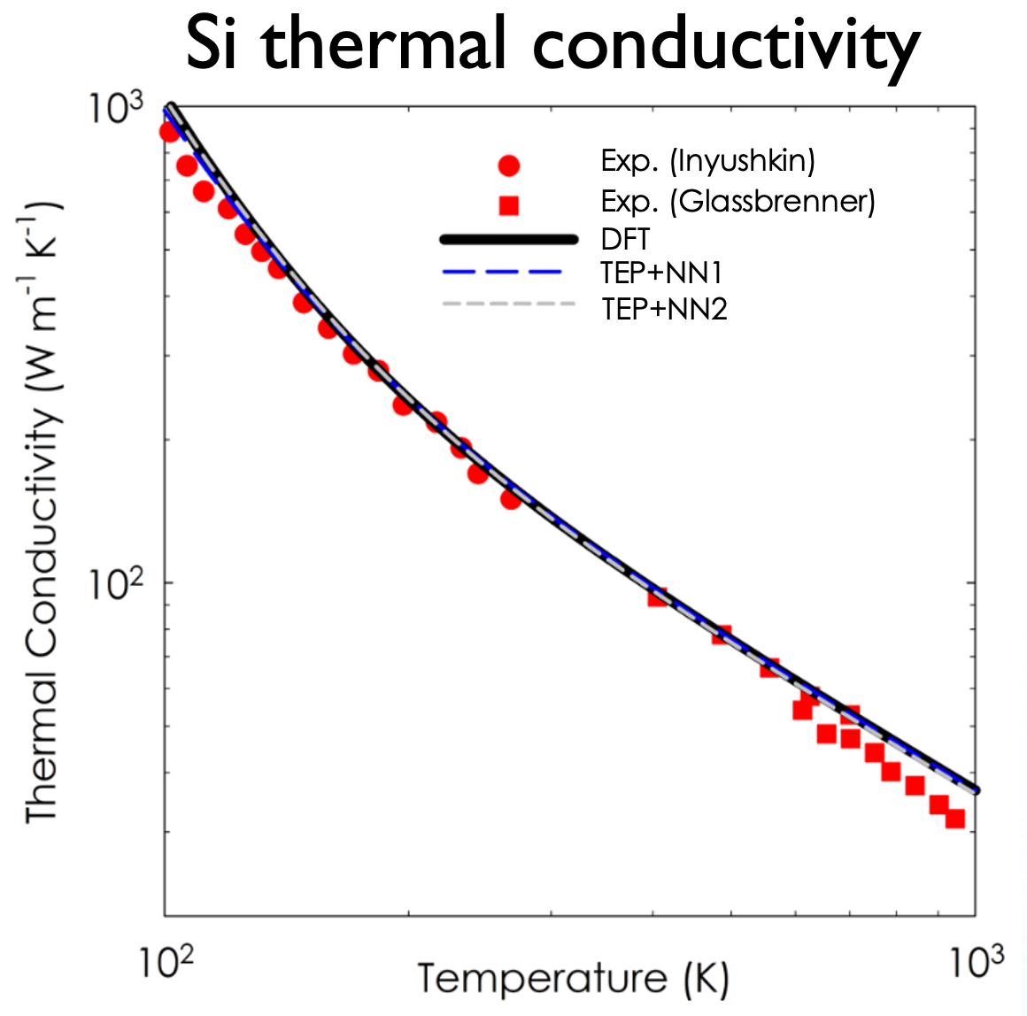

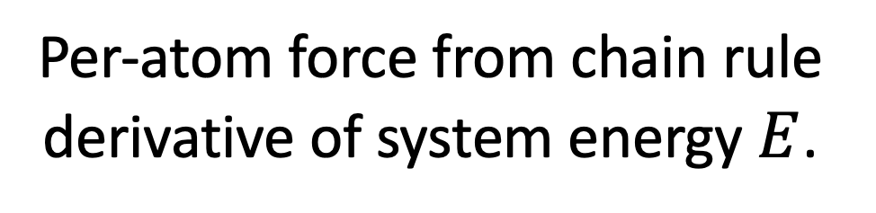
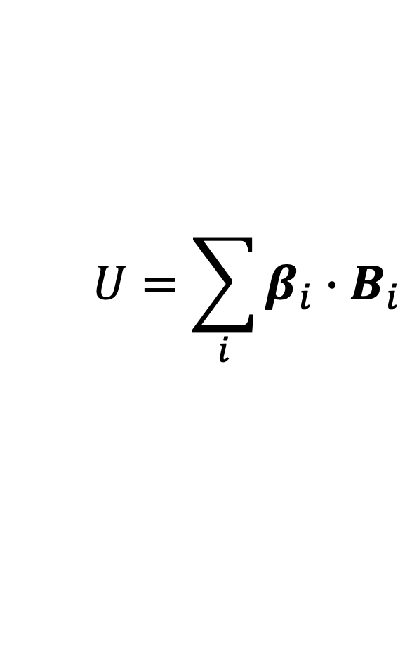
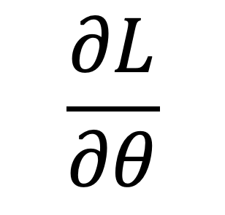
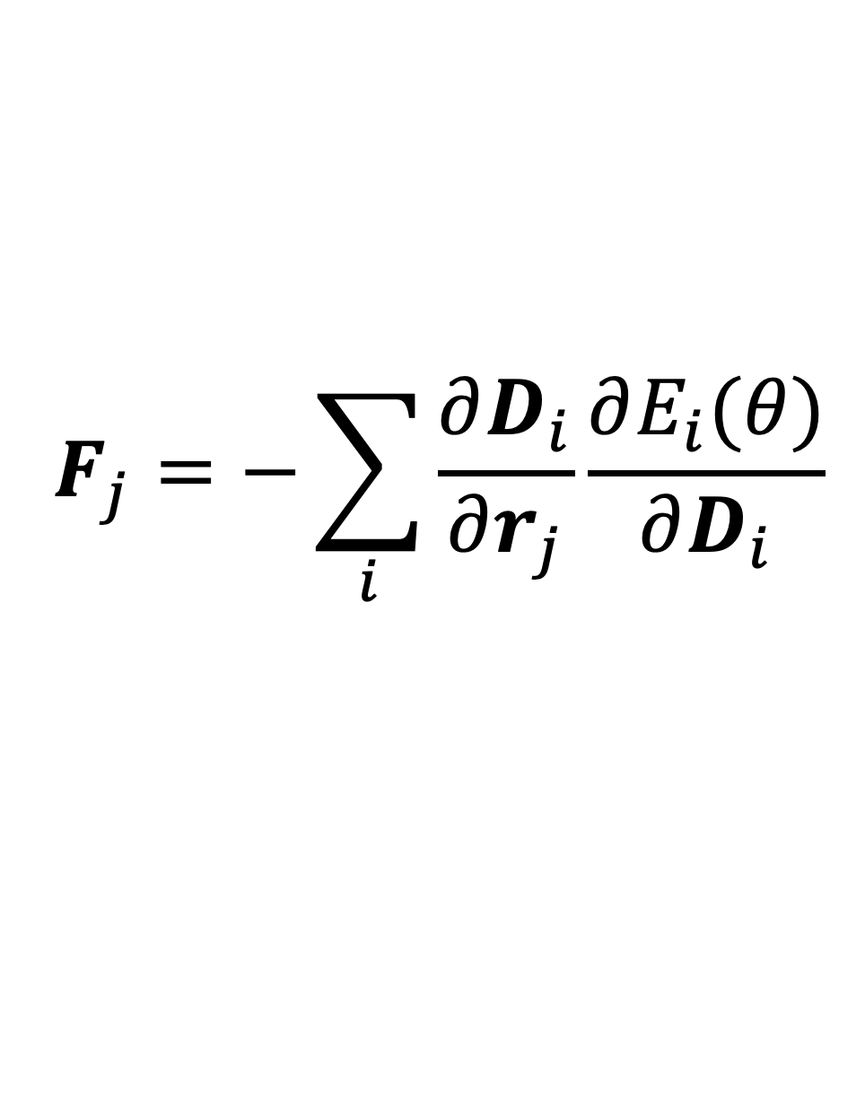
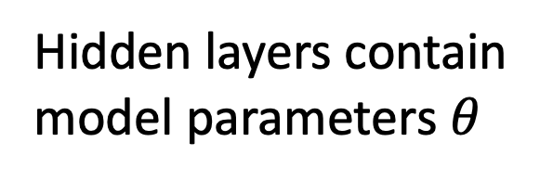
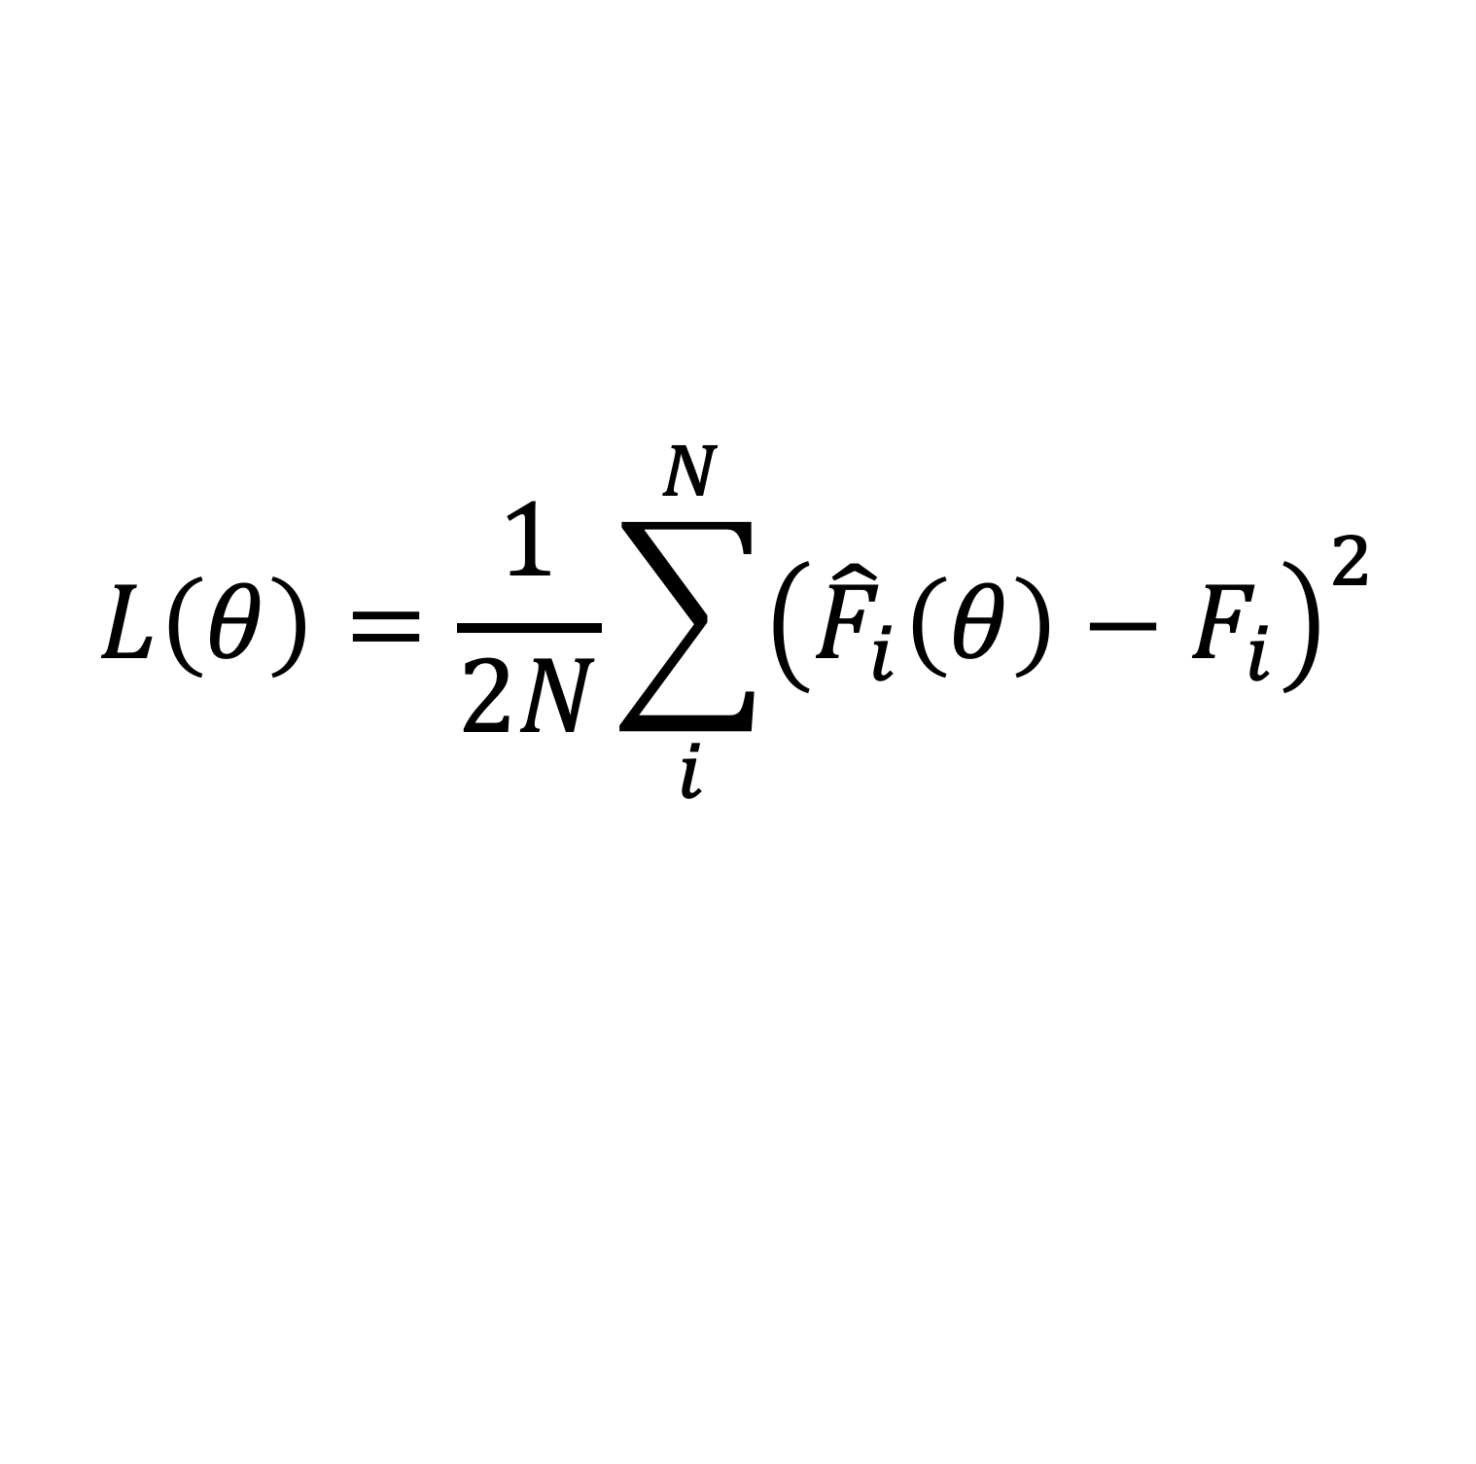
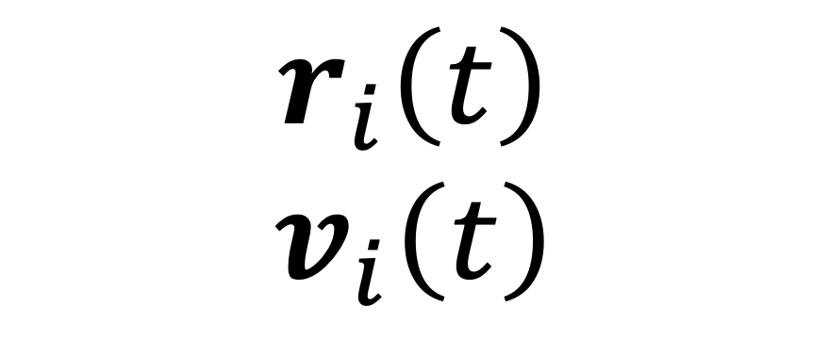

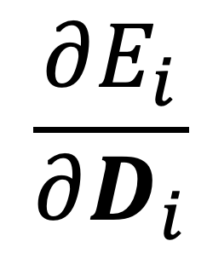
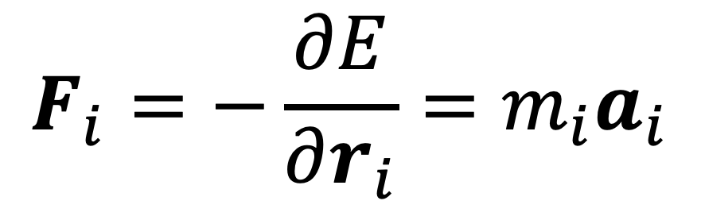
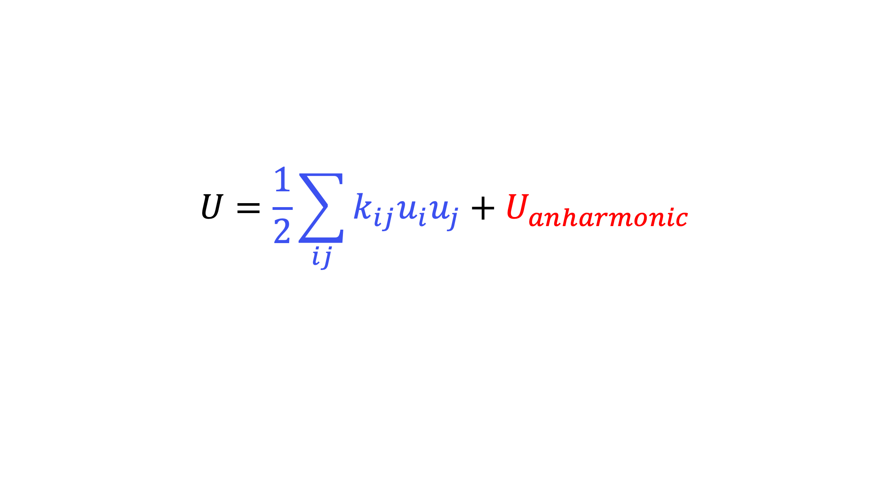
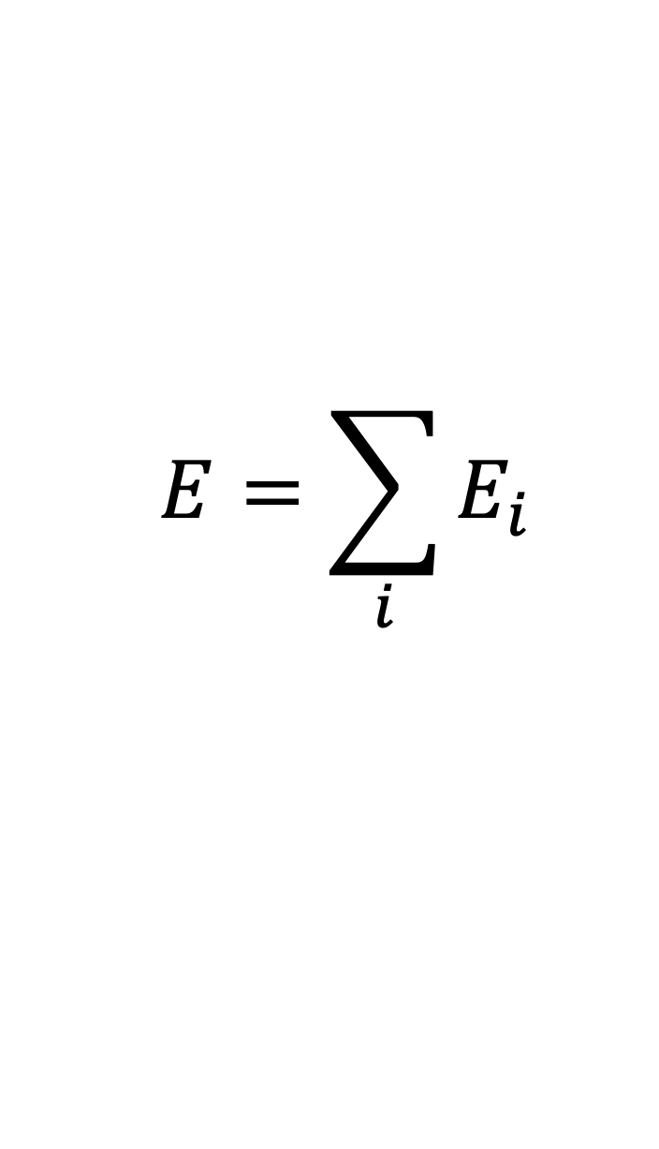
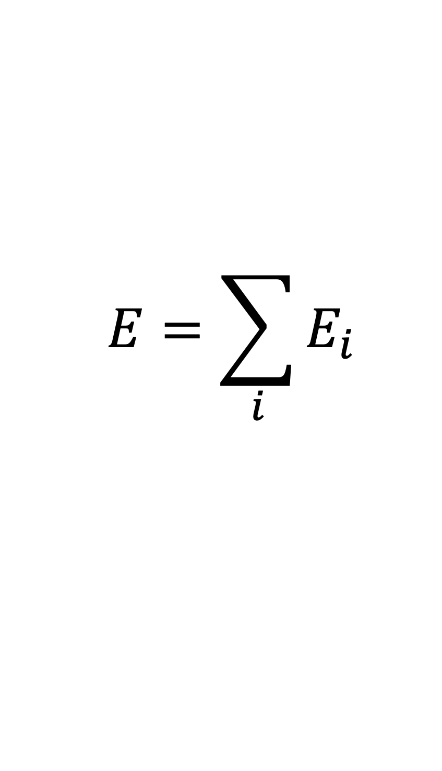
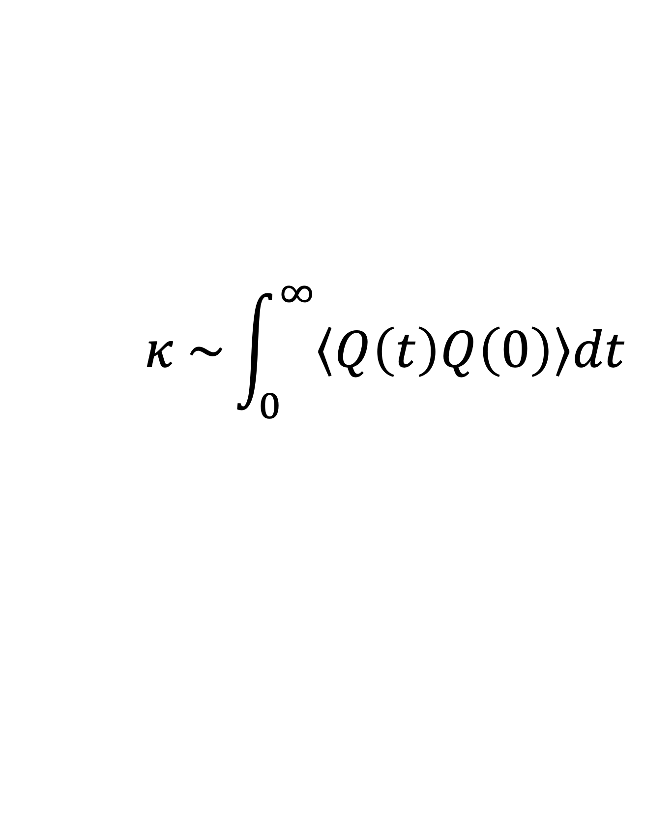
FitSNAP: Machine Learned Potentials for LAMMPS Andrew Rohskopf¹, Charlie Sievers², Megan McCarthy,¹ James Goff¹, Ember Sikorski¹, Aidan Thompson¹, Mitchell Wood¹ ¹Center for Computing Research, Sandia National Laboratories, Albuquerque, NM ²Boeing, Seattle, WA adrohsk@sandia.gov
Problem
Results
Modelling Interatomic Interactions
Predicting atomic motion is at the heart of material property prediction & design.
Potentials are at the heart of predicting atomic motion.
Machine learned interatomic potentials are a convenient and effective way of learning interatomic interactions
No package for generally making ML potentials
We introduce FitSNAP to fill this gap
Fit Forces Using Iterated Backpropagation
Need two derivatives when training to forces
1. Forward pass on energy using a ML/autograd framework:
$$E_{i}=f(D_{i})$$
$$E=\sum_{i}{E_{i}}$$
$$\frac{∂E_{i}}{∂D_{i}}$$
2. Backward pass on energy →
3. Forward pass on forces and loss function
Calculate forces
Integrate/dynamics
Properties
$$L\left(θ\right)=\frac{1}{2N}\sum_{i}^{N}{{\left({\hat{F}}_{i}\left(θ\right)−F_{i}\right)}^{2}}$$
$$F_{i}=−\frac{∂E}{∂r_{i}}=m_{i}a_{i}$$
$$r_{i}\left(t\right)$$
$$v_{i}\left(t\right)$$
$$κ \sim \int_{0}^{∞}{\left\langle Q\left(t\right)Q\left(0\right)\right\rangle dt}$$
4. Backward pass on loss function →
$$\frac{∂L}{∂θ}$$
Advantage: LAMMPS Coupling
Example Dataset – Tantalum (solid, surface, liquid)
High performance MD in LAMMPS [1] immediately after fitting
Overlay with other potentials in huge library of LAMMPS potentials
Fit to charges, spins, and other per-atom quantities in LAMMPS
Other LAMMPS functionality
Approach
Separating Descriptors (LAMMPS) and Models (FitSNAP)
Atom-centered descriptors describe the chemical environment
Models take descriptors as inputs to calculate energy
LAMMPS calculates descriptors, FitSNAP calculates and trains models
Overlaying with other potentials thanks to LAMMPS
Hidden layers contain model parameters $θ$
Taylor expansion potential (TEP)
captures harmonic forces.
Linear SNAP/ACE/etc.
$$U=\frac{1}{2}\sum_{ij}{k_{ij}u_{i}u_{j}}+U_{anharmonic}$$
$$U=\sum_{i}{β_{i}∙B_{i}}$$
Nonlinear SNAP/ACE/etc.
$$F_{j}=−\sum_{i}{\frac{∂D_{i}}{∂r_{j}}\frac{∂E_{i}(θ)}{∂D_{i}}}$$
$$E=\sum_{i}{E_{i}}$$
Per-atom force from chain rule derivative of system energy $E$.
[5,6]
[4]
compute_snap [2]
compute_pace [3]
Any compute/descriptor in LAMMPS
PyTorch
JAX
Any ML/autograd framework
Significance
FitSNAP couples to LAMMPS to generally and rapidly prototype different ML potentials – models, descriptors, and their combinations with traditional potentials.
Plimpton, Steve, J. Comp. Phys., 1995
Thompson, Aidan et. al., J. Comp. Phys., 2015
Lysogorskiy, Yury et. al., npj Comp. Mat., 2021
4) Nilsson, G et. al., Phys. Rev. B. 1972
5) Glassbrenner, CJ et. al., Phys. Rev. 1964
6) Inyushkin A.V. et. al., Phys. Stat. Sol. 2004
2022-8098 C

